Slide 1
Advanced Spreadsheets
CMPS 1024
Inaldi Gomez

Slide 2
Objective
Conditional Logical Functions- If Function
Nested If Function
And, or, not
Vlookup
Pivot Table

Slide 3
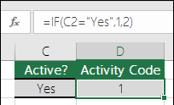
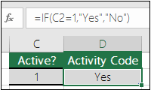
Conditional and Logical Functions
IF Function
IF(Something is True, then do something, otherwise do something else)
If statements carry two results, one for when the condition meets a true value and one result for when the condition meets a false value.

Slide 4
If Function Cont.
IF() can be used mathematical operators and perform additional calculations
IF() can be nested to do multiple comparisons
To use text in formulas use “text” quotations, except when using the word TRUE or FALSE. True or False is a key word understood in Excel.
Results such as 0 is generated when there is no argument for either value true or false
#NAME? is an error generated when the formula is misspelled
Best Practice
It is not good practice to use a literal value directly into a formula., why?
It may need to change at some point in time

Slide 5
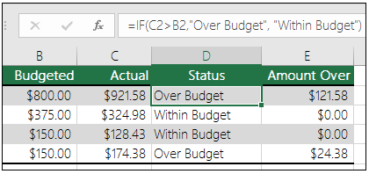
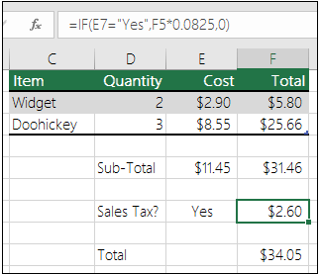
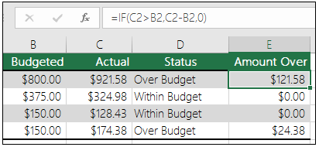
More Examples

Slide 6
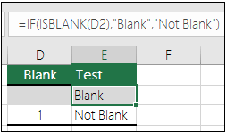
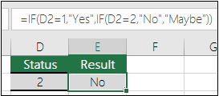
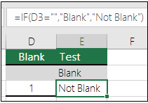
Nested IF
This is an example of a function within a function: ISBLANK()
Nested Functions can have from 3 to 64 results
Note There are 2 closing parentheses
Excel allows up to 64 Nested IF() but it is not advisable

Slide 7
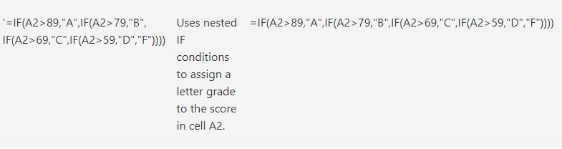
Nested Function
Both Average() and Sum() are nested in the IF Function

Slide 8

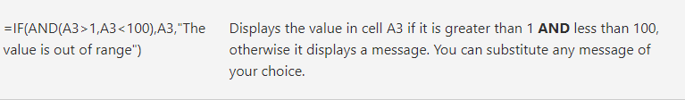

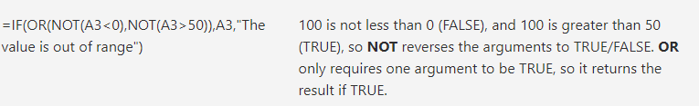


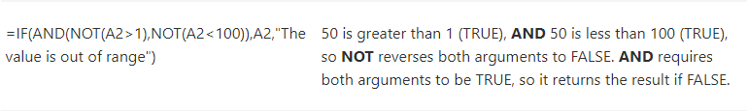



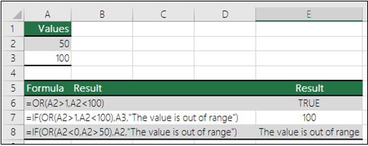
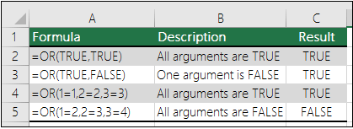
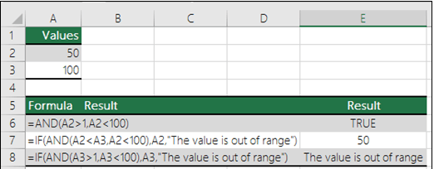
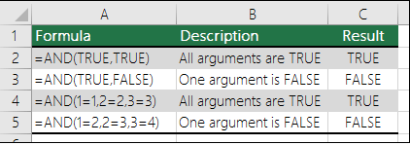
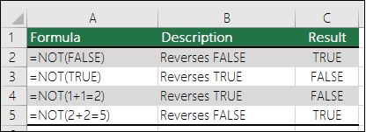
And, OR, NOT Logical Functions

Slide 9
VLOOKUP Function
Used to find values in a table or a range by row.
Eg. To look up a price of a vehicle part by part number
=VLOOKUP(value you want to look up,
range where you want to lookup the value,
The column number in the range containing the return value,
Exact Match or Approximate match – indicated by 0/False or 1/True)
Last argument is optional and the default value is True

Slide 10
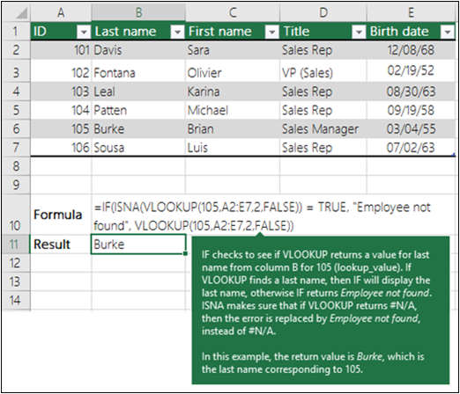
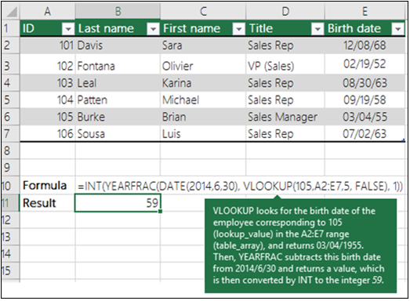
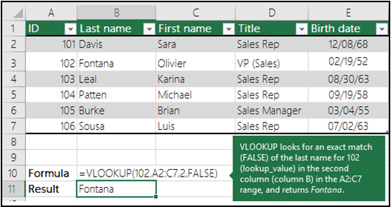
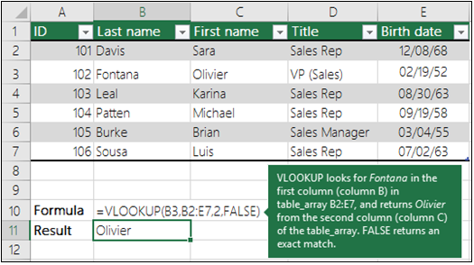
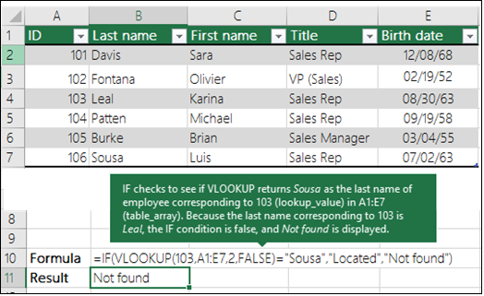
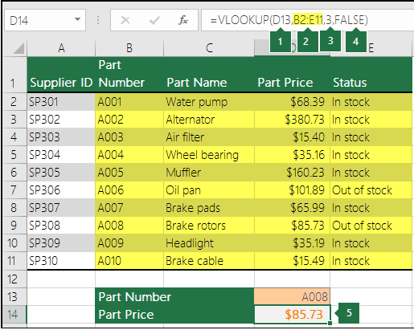
VLOOKUP Function, cont….
D13 is the lookup value, or the
cell containing the value being
looked up.
B2 to E11 that is highlighted
yellow is a range where the lookup value is located.
3 is the column number in the
Table that contains the return
Value.
False indicates if the return
value is the exact match.

Slide 11
Lesson
Pivot Table

Slide 12
Next Class
What If Analysis
PMT Function

Slide 13
Questions & Discussion

